Slide 1


Health and developmental effects of recreational screen use for school-aged children and teens

Slide 2
About us
The Canadian Paediatric Society (CPS) is a national professional association representing nearly 4000 paediatricians. The CPS advocates and educates on a range of child and youth health issues.
The Centre for Healthy Screen Use was developed by the CPS to help health professionals, policymakers, families and community members in making evidence-based decisions about child and youth screen use that keeps young people safe online.

Slide 3
How to use this presentation
This presentation discusses risks and benefits of screen use for school-aged children and teens.
Use it to engage and inform members of your community and to advocate for safer digital spaces for young people.
For more information: healthyscreenuse.cps.ca
© Canadian Paediatric Society, 2026
Content is largely based on the Canadian Paediatric Society position statement: Digital media: Promoting healthy screen use in school-aged children and adolescents. Hyperlinks have been added where other sources are used. Full reference details are included in the Notes of the appropriate slide.
Notes:
This presentation is largely based on this position statement, developed by the Canadian Paediatric Society:
Michelle Ponti; Canadian Paediatric Society, Digital Health Task Force. Digital media: Promoting healthy screen use in school-aged children and adolescents. June 6, 2019: https://cps.ca/en/documents/position/digital-media.

Slide 4
What the research says
No more than about 2 hours of recreational screen use a day is linked to positive well-being for young people, but maintaining constant connection to the online world is unhealthy.
Notes:
Reference: Toigo S, Wang C, Prince SA, Varin M, Roberts KC, Betancourt MT. Recreational screen time and mental health among Canadian children and youth. Health Promot Chronic Dis Prev Can 2025;45(7/8):311-22. doi: 10.24095/hpcdp.45.7/8.01

Slide 5

Potential benefits
Some groups of young people (e.g., geographically remote, gender questioning, racialized) can benefit from engaging with prosocial communities in ways they may not be able to do offline
Allows school-aged children to connect with friends, play active video games or watch shows/movies appropriate for their age and development
Teens can connect with friends when they are not together, through messaging, or social media engagement

Slide 6

The problem:
25% of Canadian teens 16 years and older spend 7+ hours a day on screens for personal use. The majority of time is spent on social media.
These teens report higher levels of anxiety, depression and psychological distress.
Notes:
Reference: Mental Health Research Canada. Associations between Social Media Use, Personal Screen Time, and Mental Health Indicators among Canadian youth. April 2025: https://www.mhrc.ca/screen-time-youth-mh (Accessed May 14, 2026).

Slide 7
Why screen use can be problematic
Digital platforms and services are designed to maximize user engagement, time and attention, driving unhealthy use.
Notes:
Reference: 5Rights Foundation. Disrupted Childhood: The cost of persuasive design. April 2023: https://5rightsfoundation.com/wp-content/uploads/2024/08/5rights_DisruptedChildhood_G.pdf (Accessed May 14, 2026).

Slide 8

Children and teens are uniquely vulnerable
because brain development continues well into the mid-twenties and beyond
Even if they seem mature, young people struggle with:
Impulse control
Emotional regulation
Assessing risks and consequences

Slide 9
When using screens, school-aged children and teens may:
Impulsively post content or send messages that are mean, risky, or untrue
Be unable to ignore notifications that interfere with other responsibilities, such as doing homework
Passively scroll social media platforms
Be exposed to algorithmically-driven content about body image, weight, and appearance
Not adhere to screen time limits, which can lead to conflict and missed opportunities for connection

Slide 10

Negative effects can be reversed
When youth cut back on recreational screen use to about 1-2 hours a day, they feel happier and healthier
Notes:
Reference: Davis CG, Goldfield GS. Limiting social media use decreases depression, anxiety, and fear of missing out in youth with emotional distress: A randomized controlled trial. Psychol Pop Media 2025;14(1):1–11. doi: 10.1037/ppm0000536

Slide 11
Use the 4M model to help young people develop healthier screen use:
Manage screen use
Encourage meaningful screen use
Ensure adults model healthy screen use
Monitor for signs of problematic screen use

Slide 12
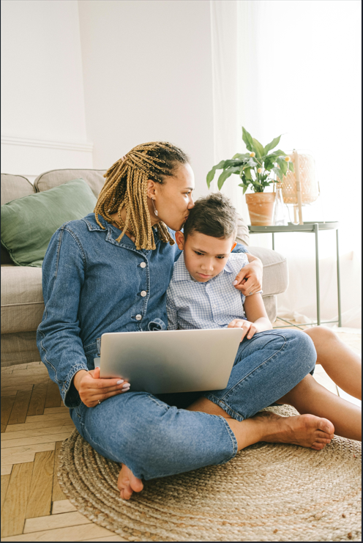
Managing screen use
Make thoughtful decisions that help school-aged children and teens engage with screens in a healthy way

Slide 13
Explore the motivation:
Example: A parent wants to give their child a smartphone
They think it’s a great gift or that their child will be excited.
(This happens a lot!)
The child’s friends and classmates have phones, and they feel left out, or parents are concerned that they might feel excluded
The child seems old enough and is mature and responsible
The child needs a phone for safety or medical reasons

Slide 14
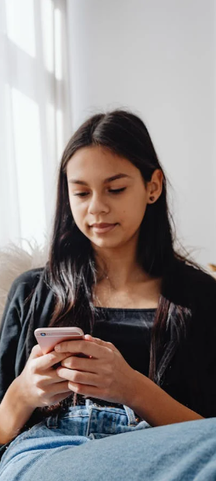
A child’s first smartphone:
What parents should know
There’s no specific age recommended by experts, but later is usually better to ensure a young person is mature and can use it responsibly
Unplugged Canada, a national parent-led organization, encourages parents to wait until children are at least 14 before they get their first smartphone.
Notes:
Reference: Unplugged Canada. https://www.unpluggedcanada.com/ (Accessed May 14, 2026).

Slide 15
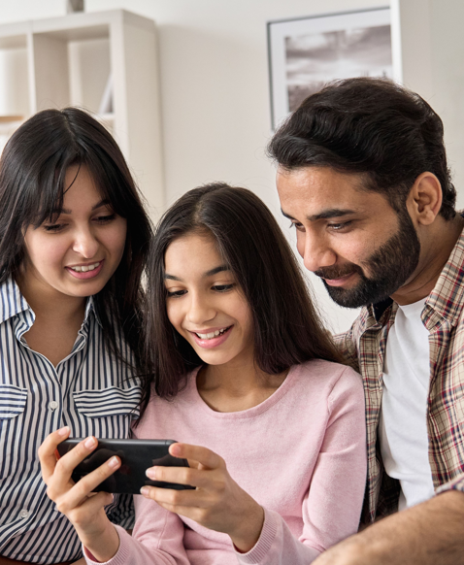
For parents who do feel their child is ready, encourage them to create an agreement with rules and expectations for phone use.

Slide 16
If parents feel pressured or aren’t sure whether their child is ready, encourage them to follow their instincts.
Also, encourage parents to explore gradual ways for children
to take on the responsibility of having a phone, such as:
Not installing social media apps on a child or teen’s smartphone
Selecting a phone for them that only allows texts and voice calls
Providing the child or teen with a shared “family” phone
*
Parents know their child best.

Slide 17
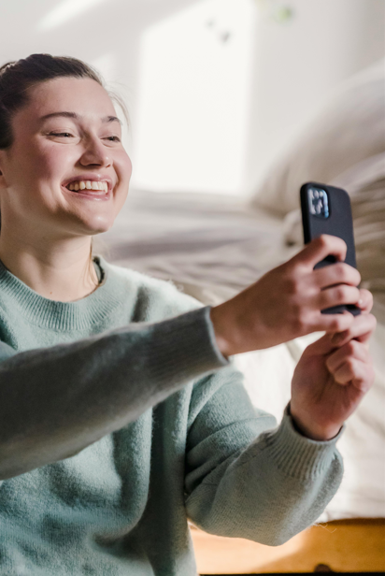
Encouraging meaningful screen use
Ensure children and teens’ screen use has purpose.
Time online must be safe and appropriate.

Slide 18
Example: A parent worries about what their child is seeing online
Encourage parents to:
Co-view content or play video games with children and teens where possible. Talk about what they are seeing online, how they interact with others, and if they have questions or concerns.
Develop a Family Media Plan that reflects each family member’s health, education and entertainments needs, considers screen use outside the home, and evolves as children grow and mature.

Slide 19

Model healthy screen use
Children and teens notice how parents use their own devices.

Slide 20
Example: Family members are often glued to devices
Encourage parents to:
Ignore devices or silence notifications during family time.
Schedule and enforce screen-free times, such as for shared meals.
Keep phones and other devices out of all bedrooms. Having screens in bedrooms reduces sleep quality and quantity for young people.
Try hobbies that family members can do together.
Eliminate dangerous behaviour like texting and driving.

Slide 21

Monitor for signs of problematic screen use
Helping children and teens learn healthy media habits can curb unhealthy screen use, but parents should watch for concerning signs.

Slide 22

What are some concerning signs?
Complaints about being bored or unhappy without access to technology.
Oppositional behaviour in response to screen time limits.
Screen use that interferes with sleep, school or face-to-face interactions.
Screen time that interferes with offline play, physical activities or socializing in person.
Negative emotions following online interactions, gaming or texting.

Slide 23
Example: Child spends most free time online
Parents can:
Talk to the child to see why they are spending so much time online. Sometimes it’s boredom!
Set limits and reflect on their own media habits to see if they can be a better role model.
Keep screens out of bedrooms, especially just before bedtime or overnight
Ask for support and resources if attempted changes at home don’t work.

Slide 24
Key takeaways:
Recreational screen use can be beneficial in moderation: no more than about 2 hours a day
Too much or inappropriate screen use can lead to poor mental health and well-being
Online platform design puts young people at risk: their brains are still developing

Slide 25
Key takeaways:
Despite the risks, there are ways to encourage healthier screen use by children and youth:
  Set limits to manage screen use
  Encourage meaningful (purposeful) use of devices
  Model responsible media use
  Monitor for signs of problematic use and seek support

Slide 26

Visit the Centre for Healthy Screen Use
for more information and resources
healthyscreenuse.cps.ca

